Slide 1
Kubernetes
Notes:
1

Slide 2
Namespaces
Partition a single Kubernetes cluster into multiple virtual clusters
Logical entity to represent cluster resources for usage of a particular set of users.
Helps to address the complexity of organizing objects within a cluster

Slide 3
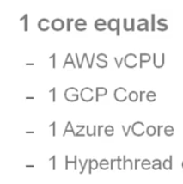
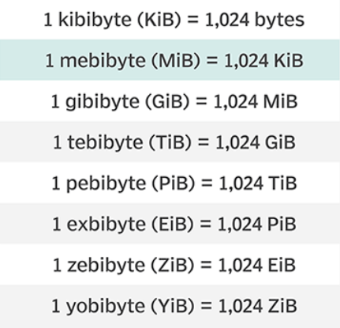
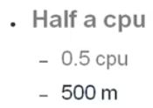
Resources
CPU
Memory
CPU usage can be compressed and thus can be throttled
Memory can’t be throttled

Slide 4
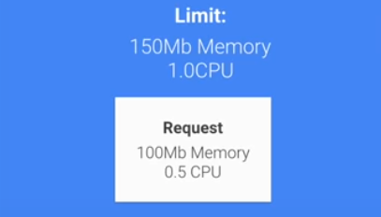
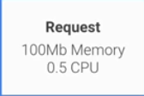
Requests and Limits
Requests are what the container is guaranteed to get
Limits make sure a container never goes above a certain value

Slide 5
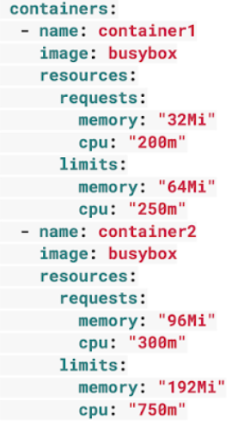
Resources and Limits
CPU resources are defined in milli core
Memory in defined in bytes

Slide 6
Resource Quotas
Production and Staging resources in Kubernetes cluster
Want to give required resources to Production resources in case of spike

Slide 7
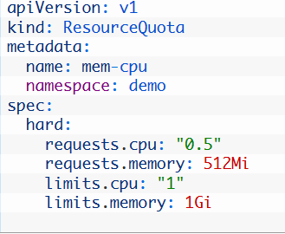
Resource Quotas
requests.cpu Maximum combined CPU requests in millicores for all the containers in the Namespace.
limits.cpu is the maximum combined Memory limits for all containers in the Namespace
requests.memory Maximum combined Memory requests for all the containers in the Namespace
limits.memory Maximum combined Memory limits for all the containers in the Namespace

Slide 8
Limit Range
How do we avoid creation of too many tiny containers ?
How to limit containers which consume super large resources ?

Slide 9
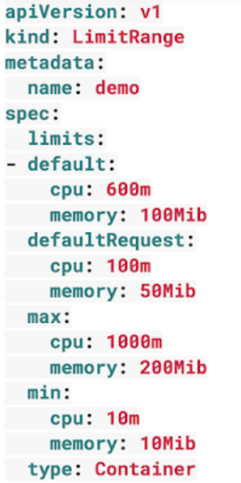
Limit Range
LimitRange applies to an individual container
Default request/limit for compute resources
Enforce minimum and maximum compute resources usage per Pod or Container

Slide 10
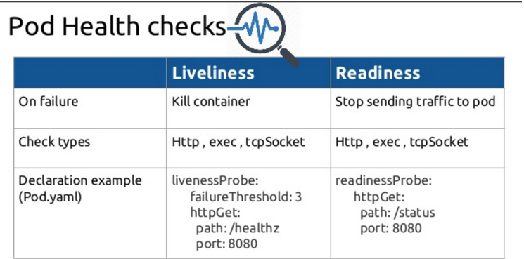
POD Health Check
Enable to make their containerized applications more reliable and robust
Liveness Probe - Kubernetes uses liveness probes to know when to restart a container
Readiness Probe - to decide when the container is available for accepting traffic

Slide 11
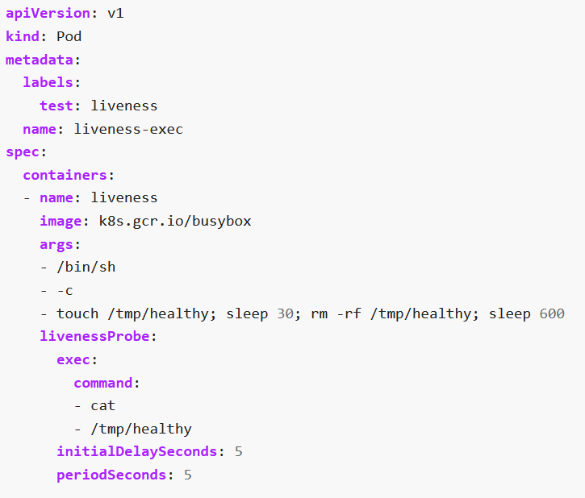
Liveness Probe
The Liveness state of an application tells whether the internal state is valid.
If Liveness is broken, this means that the application itself is in a failed state and cannot recover from it.
Under what circumstances is it appropriate to restart the pod?

Slide 12
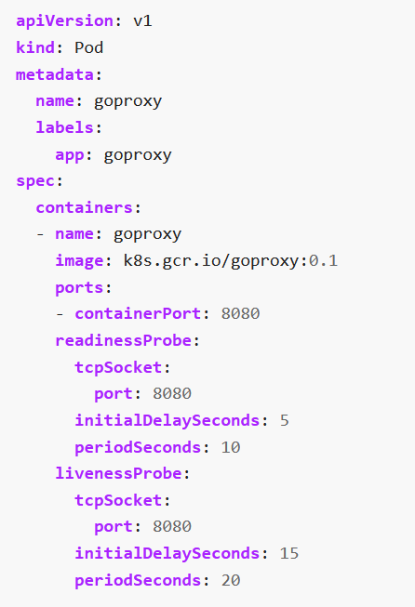
Readiness Probe
kubelet uses readiness probes to know when a container is ready to start accepting traffic.
Under what circumstances should we take the pod out of the list of service endpoints so that it no longer responds to requests?

Slide 13
Tuning Parameters
initialDelaySeconds - How long to wait before sending a first probe after a container starts.
timeoutSeconds How long a request can take to respond before it’s considered a failure.
periodSeconds How often a probe will be sent.

Slide 14
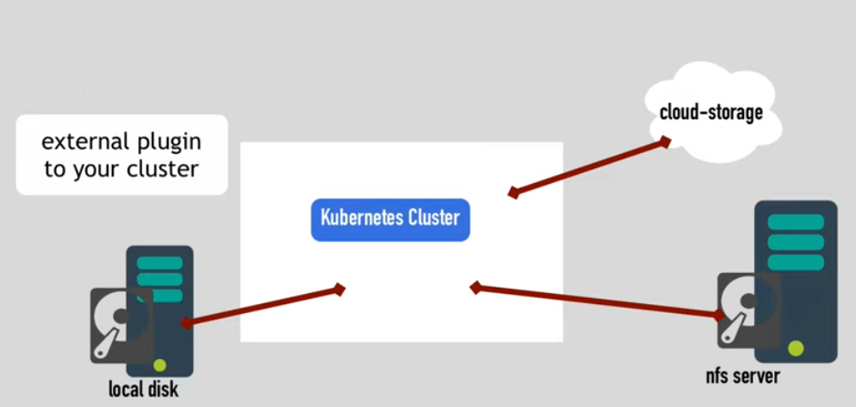
Persistent Volume

Slide 15
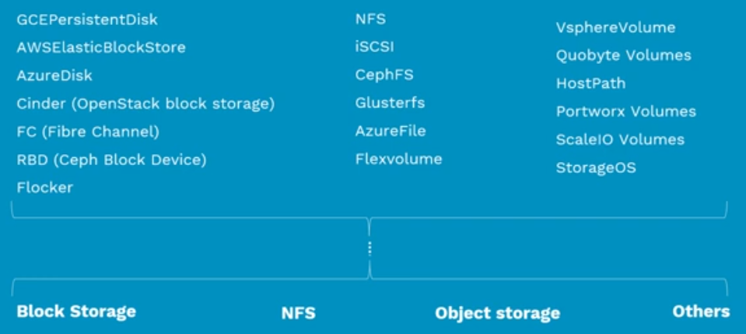
Persistent Volume

Slide 16
Persistent Volumes
Standard API
Block Storage
NFS
Object Storage
Cloud Storage

Slide 17
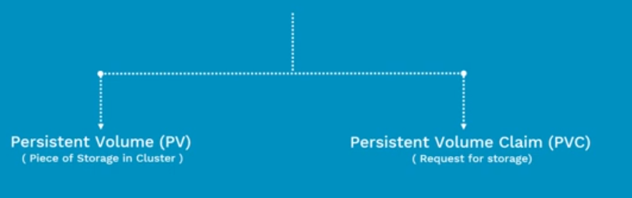
Persistent Volumes
Abstract details of how storage is provided from how it is consumed

Slide 18
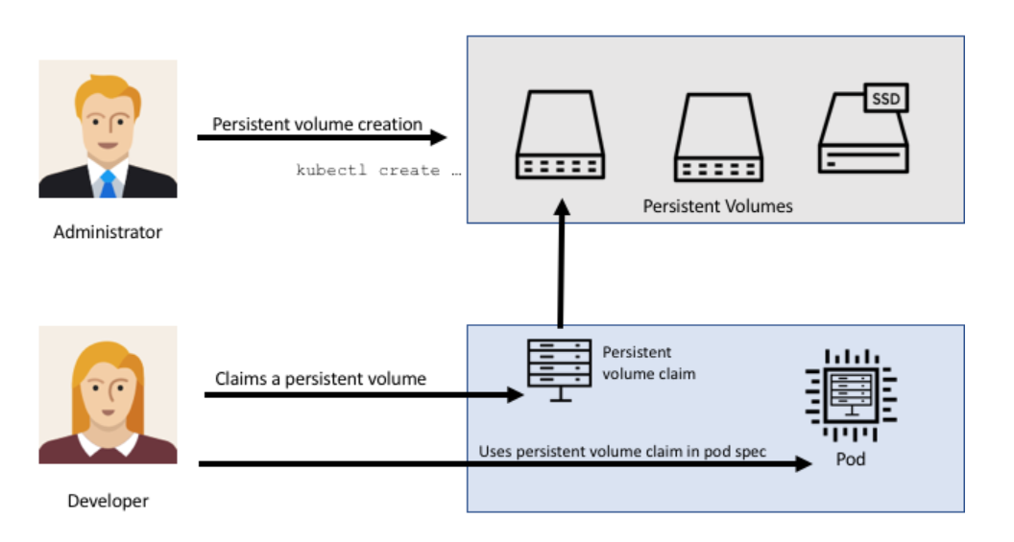
Persistent Volume

Slide 19
What is Persistent Volume (PV)?
Pre Provisioned storage in a Kubernetes cluster
Represent the backend storage entity that a pod might consume.
Data can exists beyond the lifecycle of a POD

Slide 20
Persistent Volume
Capacity - storage capacity
apiVersion: v1
kind: PersistentVolume
metadata:
name: pv0003
spec:
capacity: storage: 5Gi
accessModes: - ReadWriteOnce
persistentVolumeReclaimPolicy: Recycle
nfs:
path: /tmp
server: 172.17.0.2
Access Modes - ReadWriteOnce
ReadOnlyMany
ReadWriteMany
Recycling Policy Retain (manual reclaim)
Recycle (deprecated)
Delete

Slide 21


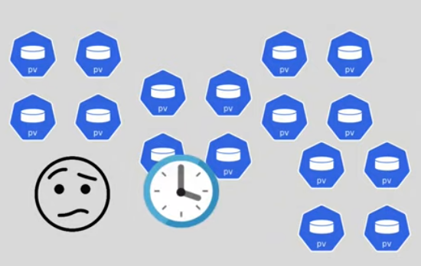
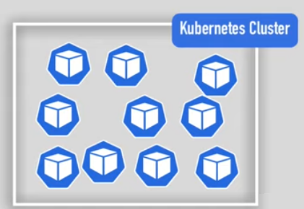
Persistent Volume

Slide 22
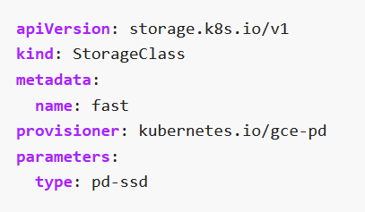

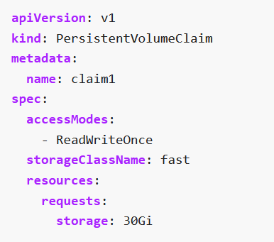
Dynamic Provisioning of volumes
Provisions Persistent volumes dynamically
Users can request dynamically provisioned storage by including a storage class annotation in their persistent volume claim

Slide 23
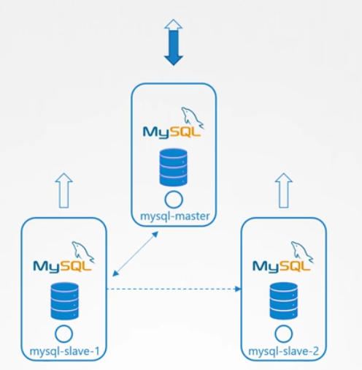
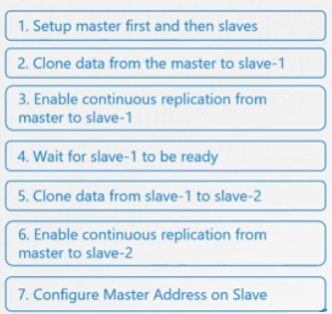

StatefulSet

Slide 24
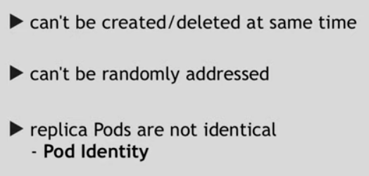
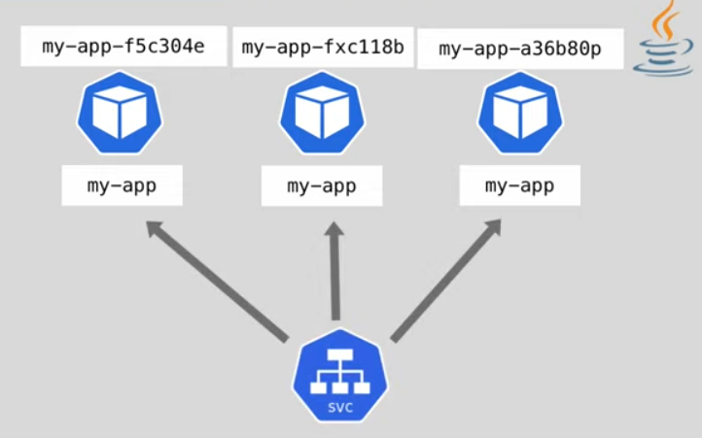
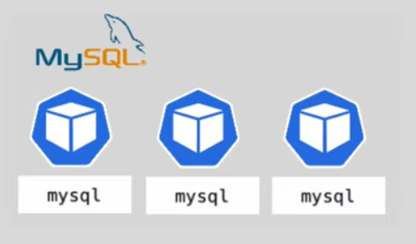
StatefulSets

Slide 25
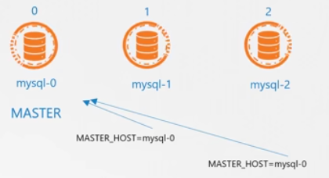
StatefulSets
PODs are created in sequential order
Once the first POD is ready and in running state, next pod will be created
Assign a unique index to each POD in increment order

Slide 26
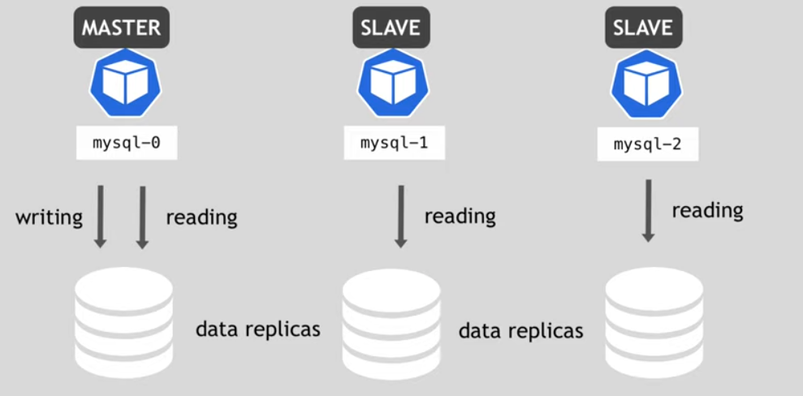
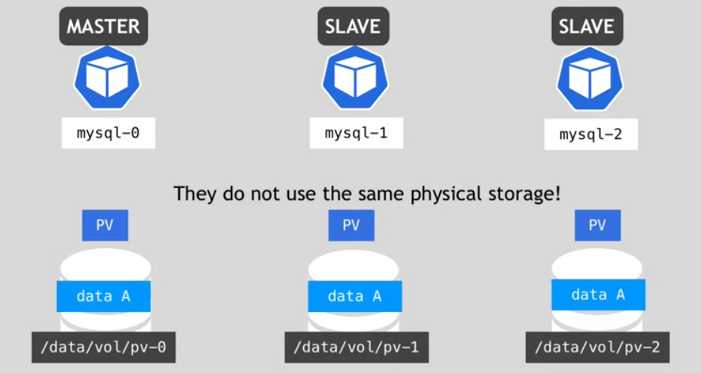
StatefulSets

Slide 27
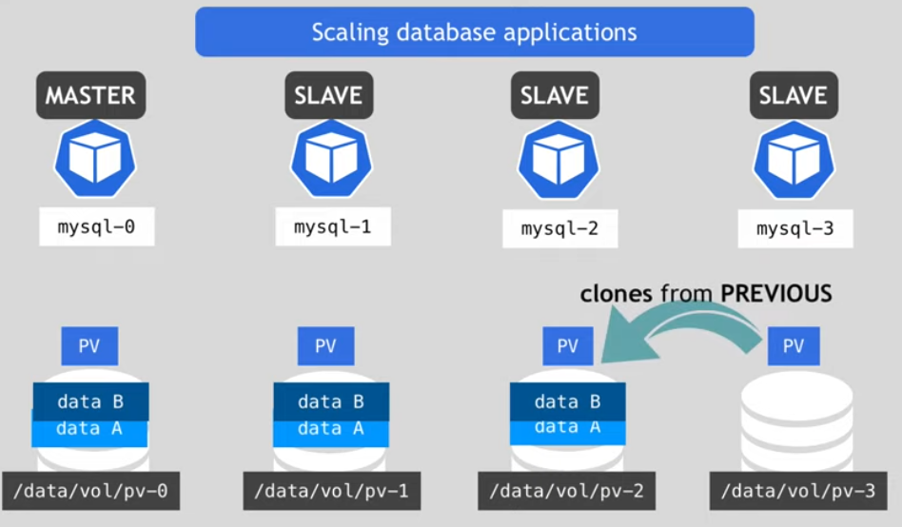
StatefulSets

Slide 28
Ingress

Slide 29
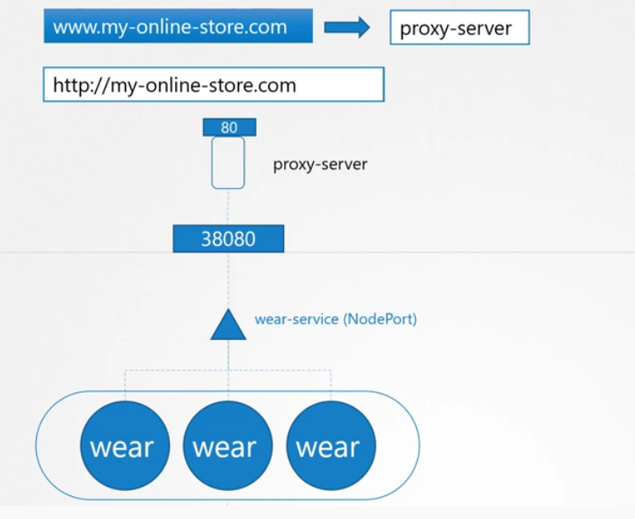
Ingress?

Slide 30
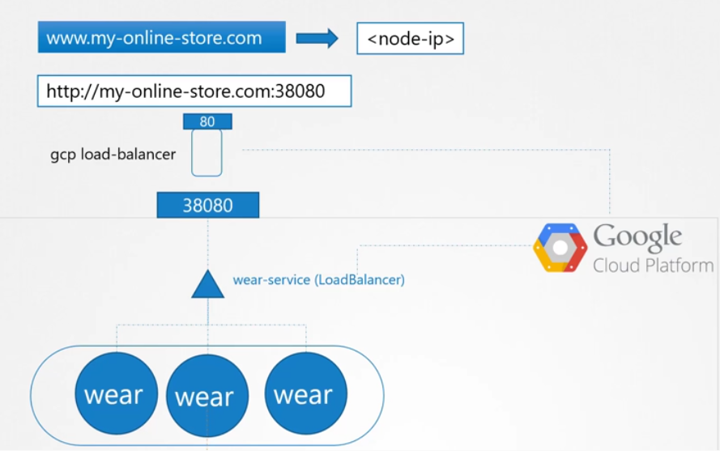
Loadbalancer

Slide 31
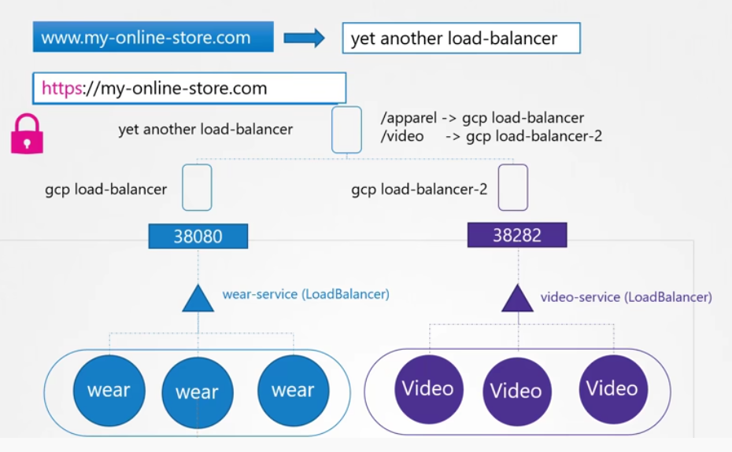
Ingress

Slide 32
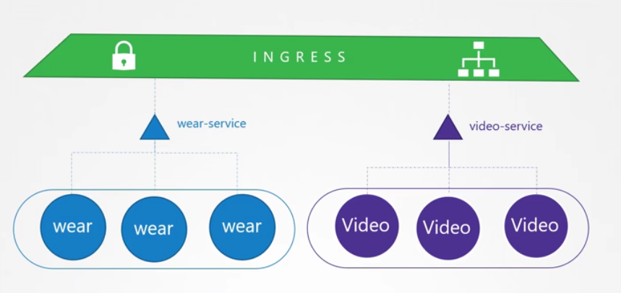
Ingress

Slide 33
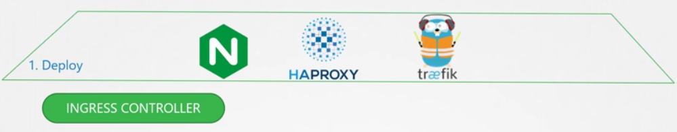

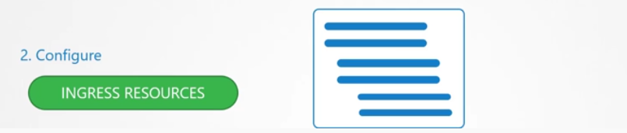
Ingress

Slide 34
POD Preset
A PodPreset is an API resource for injecting additional runtime requirements into a Pod at creation time.
We use label selectors to specify the Pods to which a given PodPreset applies.

Slide 35
Enable POD Preset
kube-apiserver configuration, include below settings
--extra-config=apiserver.enable-admission-plugins=PodPreset
-- runtime-config=settings.k8s.io/v1alpha1=true

Slide 36
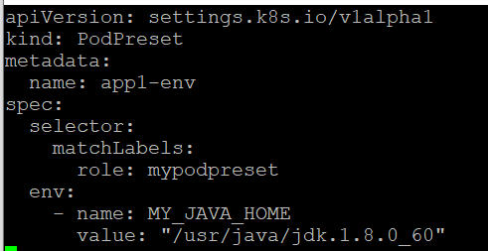
POD Preset
When a pod creation request occurs, the system does the following:
Retrieve all PodPresets available for use
Check if the label selectors of any PodPreset matches
Merge the various resources defined by the PodPreset into the Pod

